Slide 1
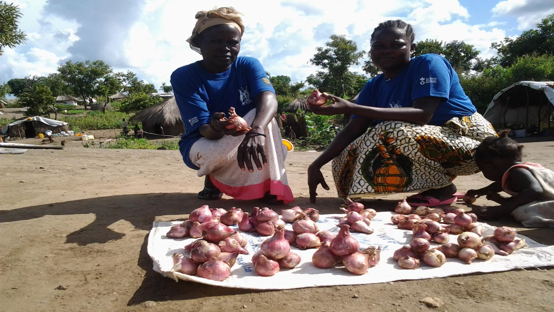
LIVELIHOODS IN BIDIBIDI
Settlement transformation agenda (STA)
Arua, 26th October 2017

Slide 2
BACKGROUND
Agro-based intervention
(distribution of seeds, and tools; agronomic practices; agricultural demo garden; Kitchen garden/vegetable; growing orange fleshed sweet potatoes production; distribution of drought resistant pigeon pea iron rich beans; Fruits trees distribution, etc.)
Cash grant
Unconditional Cash grants; Multipurpose grant support; Livelihood Assests protection grant; Asset Protection cash grant; Cash grants to small scale business groups; training, etc.)
VSLA (Village Savings and Loans Association)
Identification and registration of VSLA beneficiaries; Trainings
Cash for work
(roads rehabilitation and opening, tree planting, land opening and hut construction for PSN, bricks laying and pit latrines excavation, etc.)
Income Generating Activities
Tree Nursery Management; stove construction and handicraft; soap making, beekeeping project; Small business developed; trainings, etc.)
Vocational skills training
Metal fabrication, building and practice, carpentry and joinery; motorvihicle; Fashion and design (tailoring ); ICT training, etc.
Zones | Total population | Households total
Zone 1 | 36,466 | 8,047
Zone 2 | 48,072 | 12,157
Zone 3 | 65,954 | 19,720
Zone 4 | 42,246 | 9,314
Zone 5 | 75,597 | 14,016
Total | 268,335 | 63,254

Slide 3
Repartition of partners by activity
22 Partners for livelihoods activities out of them 16 focused on agro-based intervention
Partners | Agro-based support | Cash grant | VSLA | Cash for work (CFW) | Income Generating Activities | Vocational training
IP | DCA, OPM, Finn Church Aid (FCA) | DCA | DCA | DCA | DCA
OP | Samaritan’s Purse Action Against Hunger Caritas ADRA; NRC ; ARC; ZOA; ACTED; CRS Mercy Corps; FCA; AFARD Malteser International AD/Marian Brothers | TPO; IRC WVI (in 2016) Mercy Corps NRC; CRS Save the Children | IRC; FCA; CRS; Mercy Corps | IRC; CRS Mercy Corps Action Against Hunger Samaritan’s Purse Save the Children | Action Against Hunger IRC; URDMC; ADRA Mercy Corps FCA; CRS; DRC | Action Against Hunger CEFORD; URDMC Caritas; FCA; CRS; DRC AD/Marian Brothers
Total | 16 | 8 | 5 | 7 | 9 | 8
UN-System = UNHCR, UNDP, FAO

Slide 4
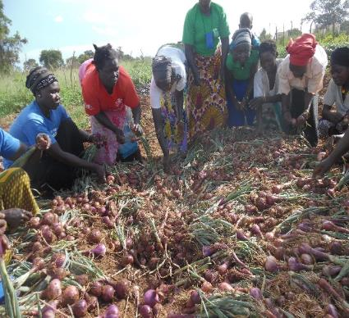
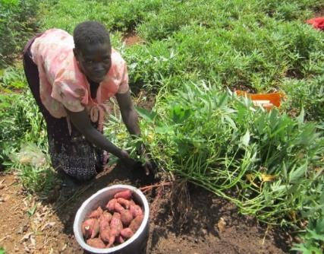
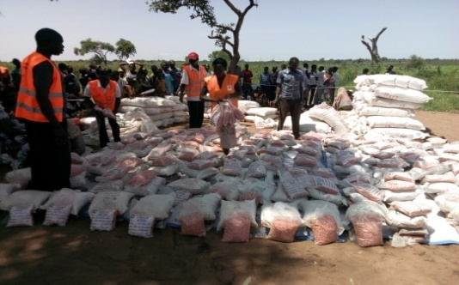
Agro-based intervention
Activities | Key achievement |  | Total
 | Refuges | Host community
Land allocation | 44,000 | - | 44,000
Seeds and tools distribution | 35,776 | 10,479 | 46,255
Agronomic practices | 5,408 | 2,318 | 7,726
Agricultural demo garden | 1,690 | 724 | 2,414
Fruits trees distribution | 4,470 | 1,916 | 6,386
Kitchen garden/vegetable growing | 13,681 | 5,863 | 19,544
Orange fleshed sweet potatoes production | 5,670 | 2,430 | 8,100
Distribution of drought resistant pigeon pea iron rich beans | 11,037 | 4,730 | 15,767
Total | 77,732 | 28,460 | 106,192

Slide 5
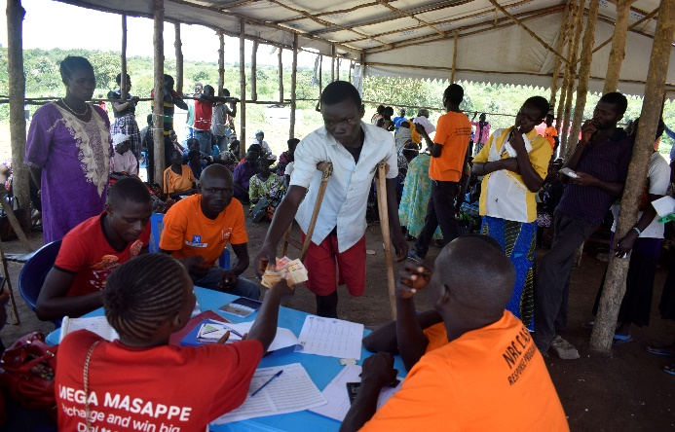
Cash grant
Activities | Key achievement |  | Total
 | Refuges | Host community
Unconditional Cash grants | 1,797 | 1,027 | 2,824
Multipurpose grant support | 25,420 | 10,894 | 36,314
Livelihood Assests protection grant | 1,246 | 534 | 1,780
Asset Protection cash grant | 11,256 | 4,824 | 16,080
Cash grants to small scale business groups | 164 | 66 | 230
Training | 39,883 | 17,345 | 57,228
Total | 39,883 | 17,345 | 57,228

Slide 6
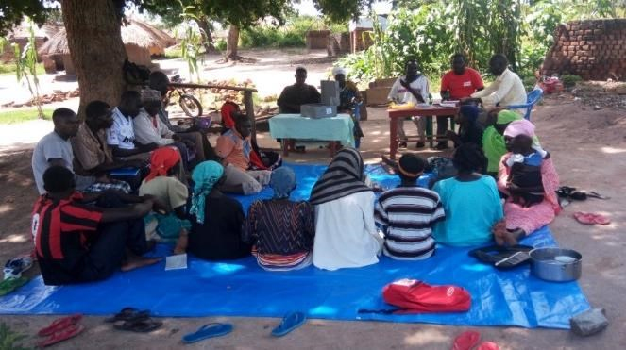
VSLA (Village Savings and Loans Association)
Activities | Key achievement |  | Total
 | Refuges | Host community
Identification and registration of VSLA beneficiaries | 1,729 | 741 | 2,470
Trainings | 1,729 | 741 | 2,470
Total | 1,729 | 741 | 2,470

Slide 7
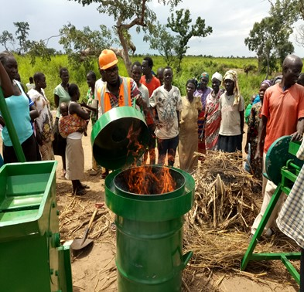
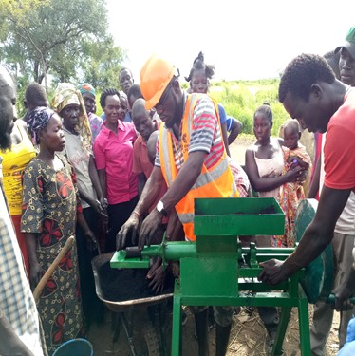
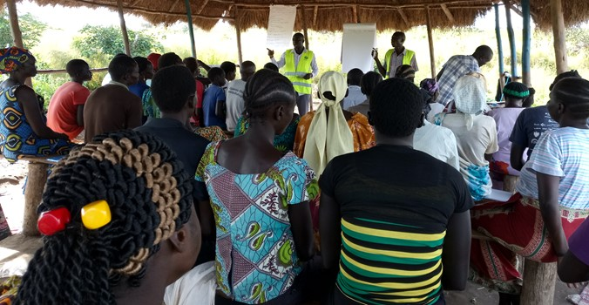
IGA (Income Generating Activities)
Activities | Key achievement |  | Total
 | Refuges | Host community
Tree Nursery Management | 80 | 45 | 125
Soap making | 30 | 20 | 50
Briquettes making | 56 | 0 | 56
Small business developed | 165 | 15 | 180
Trainings | 331 | 80 | 411
Total | 331 | 80 | 411

Slide 8
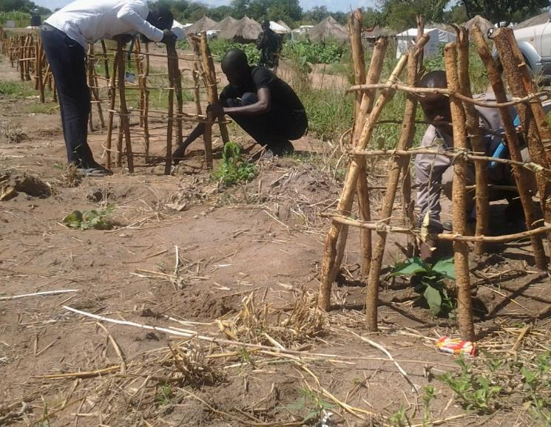
Cash for work
Activities | Key achievement |  | Total
 | Refuges | Host community
Roads rehabilitation and opening | 575 | 235 | 810
Tree planting | 590 | 380 | 970
PSN land opening and hut construction | 294 | 135 | 429
Bricks laying and pit latrines excavation | 927 | 408 | 1,335
Total | 2,386 | 1,158 | 3,544

Slide 9
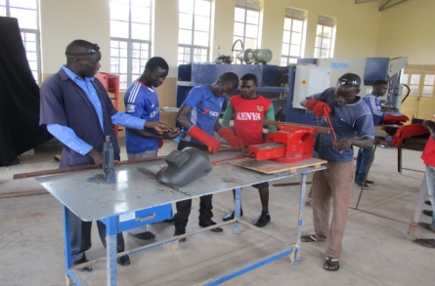
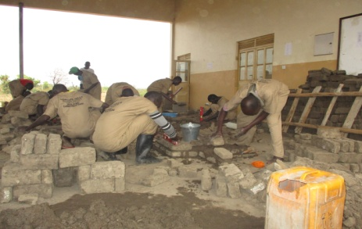
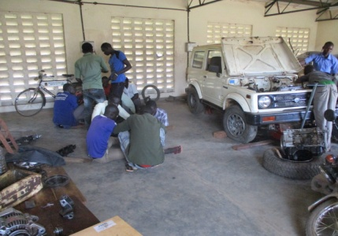
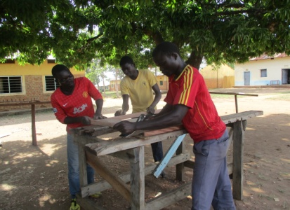
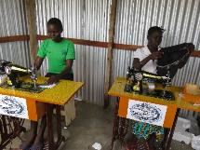
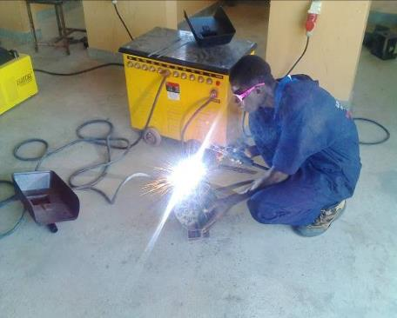
Vocational training
Activities | Key achievement |  | Total
 | Refuges | Host community
Metal fabrication, building and practice, carpentry and joinery , motor vehicle mechanics | 69 | 28 | 97
Fashion and design (tailoring ) | 18 | 8 | 26
ICT training | 54 | 11 | 65
Total | 141 | 47 | 188

Slide 10
Major gaps and challenges
As shown, IP/OP have not put more emphasis on vocational training and IGA which could help people to build their resilience.
Most activities related to cash grant have a duration of 3 or 4 month. These activities are always completed before the beneficiaries realize the value. This is also applies to cash for work activities.
Some places are very rocky and not favorable for farming.
The allocated land for farming is so far from the zones.
Intimidation of refugees by the host community to access and cultivate the allocated farm lands.
Poor roads delays delivery of assistance within the zones as well as preventing beneficiary’s movements.

Slide 11
Recommendations
To have a sustainable livelihoods within the settlement more attention should be given to IGA activities and vocational skills training in order to enhance resilience;
More sensitize of host community members on peaceful coexistence;
More advocacy on land access and use;
Improve road network;
Value chain analysis and market linkages;
More emphasis on integrated livestock/crop production/environment management;
Land allocation process should consider the family size;
Encourage farmer field school approach to ensure better utilization of the allocated land;

Slide 12
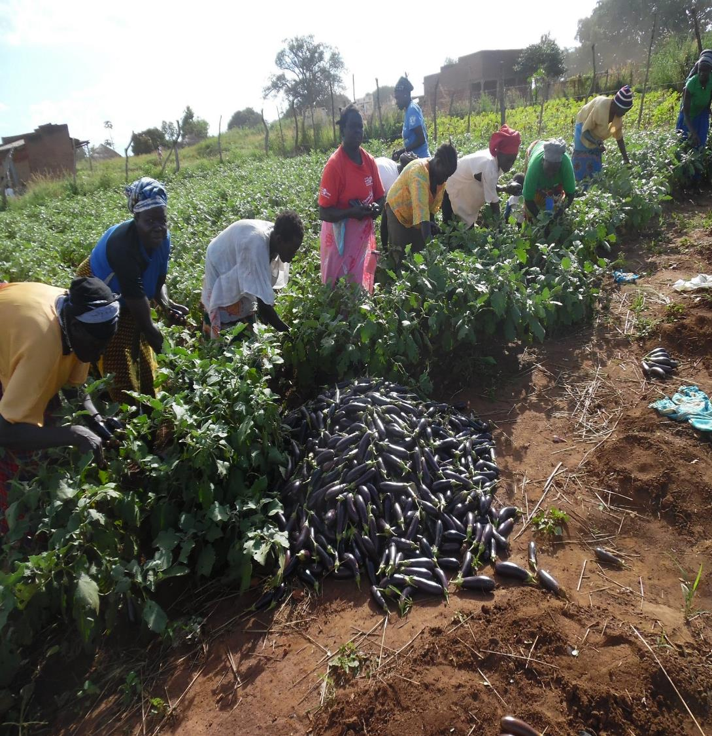
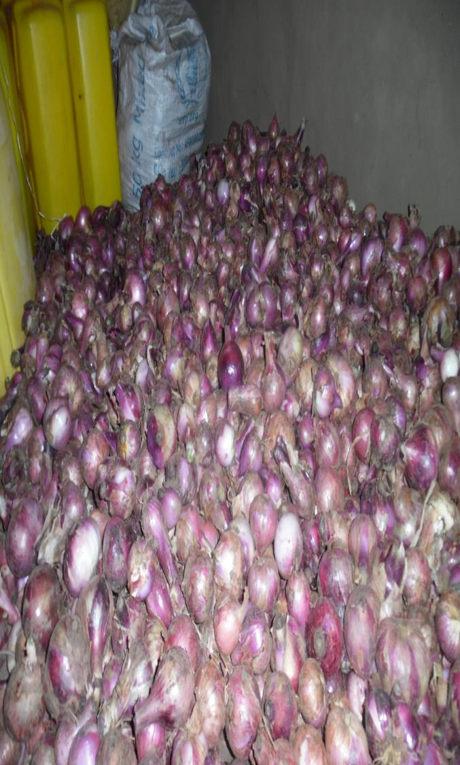
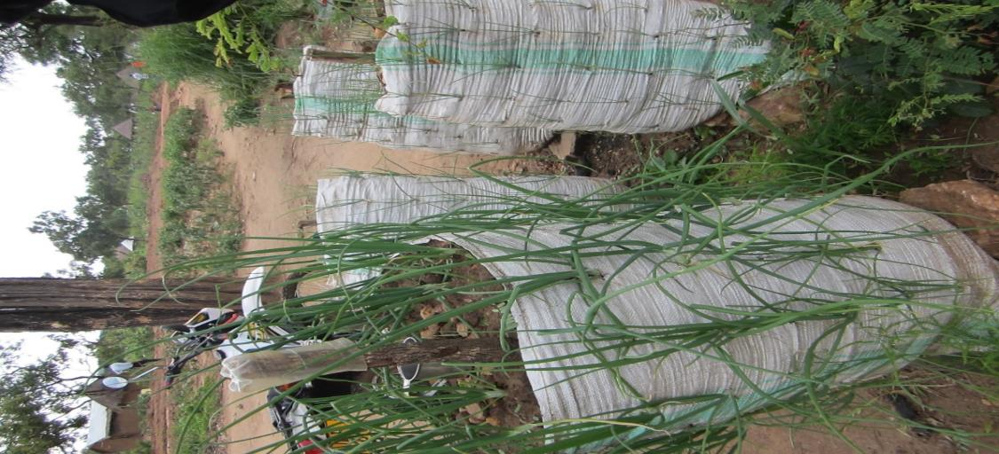
Thanks for your attention

